Slide 1
Example & step-by-step problem solving for k-Medians/k-Medoids & Hierarchical Clustering
-By Team 3

Slide 2
Roadmap
Unsupervised learning
Clustering categories
Clustering algorithms
K-means
Fuzzy c-means
Kernel-based
Graph-based
Q&A

Slide 3
Unsupervised learning
Definition 1
Supervised: human effort involved
Unsupervised: no human effort
Definition 2
Supervised: learning conditional distribution P(Y|X), X: features, Y: classes
Unsupervised: learning distribution P(X), X: features

Slide 4
Clustering
What is clustering?

Slide 5
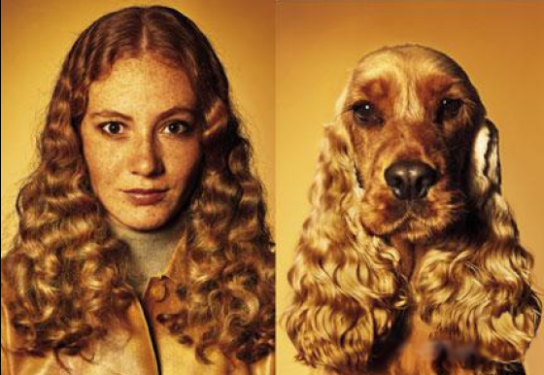
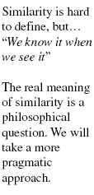
Clustering
Definition
Assignment of a set of observations into subsets so that observations in the same subset are similar in some sense

Slide 6
Clustering
Hard vs. Soft
Hard: same object can only belong to single cluster
Soft: same object can belong to different clusters

Slide 7
Clustering
Hard vs. Soft
Hard: same object can only belong to single cluster
Soft: same object can belong to different clusters
E.g. Gaussian mixture model

Slide 8
Clustering
Flat vs. Hierarchical
Flat: clusters are flat
Hierarchical: clusters form a tree
Agglomerative
Divisive

Slide 9
Hierarchical clustering
Agglomerative (Bottom-up)
Compute all pair-wise pattern-pattern similarity coefficients
Place each of n patterns into a class of its own
Merge the two most similar clusters into one
Replace the two clusters into the new cluster
Re-compute inter-cluster similarity scores w.r.t. the new cluster
Repeat the above step until there are k clusters left (k can be 1)

Slide 10
Hierarchical clustering
Agglomerative (Bottom up)

Slide 11
Hierarchical clustering
Agglomerative (Bottom up)
1st iteration
1

Slide 12
Hierarchical clustering
Agglomerative (Bottom up)
2nd iteration
1
2

Slide 13
Hierarchical clustering
Agglomerative (Bottom up)
3rd iteration
3
1
2

Slide 14
Hierarchical clustering
Agglomerative (Bottom up)
4th iteration
3
1
2
4

Slide 15
Hierarchical clustering
Agglomerative (Bottom up)
5th iteration
3
1
2
5
4

Slide 16
Hierarchical clustering
Agglomerative (Bottom up)
Finally k clusters left
3
9
6
1
2
5
8
4
7

Slide 17
Hierarchical clustering
Divisive (Top-down)
Start at the top with all patterns in one cluster
The cluster is split using a flat clustering algorithm
This procedure is applied recursively until each pattern is in its own singleton cluster

Slide 18
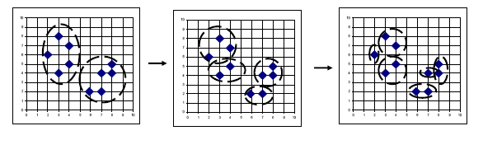
Hierarchical clustering
Divisive (Top-down)

Slide 19
Bottom-up vs. Top-down
Which one is more complex?
Which one is more efficient?
Which one is more accurate?

Slide 20
Bottom-up vs. Top-down
Which one is more complex?
Top-down
Because a flat clustering is needed as a “subroutine”
Which one is more efficient?
Which one is more accurate?

Slide 21
Bottom-up vs. Top-down
Which one is more complex?
Which one is more efficient?
Which one is more accurate?

Slide 22
Bottom-up vs. Top-down
Which one is more complex?
Which one is more efficient?
Top-down
For a fixed number of top levels, using an efficient flat algorithm like K-means, divisive algorithms are linear in the number of patterns and clusters
Agglomerative algorithms are least quadratic
Which one is more accurate?

Slide 23
Bottom-up vs. Top-down
Which one is more complex?
Which one is more efficient?
Which one is more accurate?

Slide 24
Bottom-up vs. Top-down
Which one is more complex?
Which one is more efficient?
Which one is more accurate?
Top-down
Bottom-up methods make clustering decisions based on local patterns without initially taking into account the global distribution. These early decisions cannot be undone.
Top-down clustering benefits from complete information about the global distribution when making top-level partitioning decisions.

Slide 25
K-means
Data set:
Clusters:
Codebook :
Partition matrix:
Minimizes functional:
Iterative algorithm:
Initialize the codebook V with vectors randomly picked from X
Assign each pattern to the nearest cluster
Recalculate partition matrix
Repeat the above two steps until convergence

Slide 26
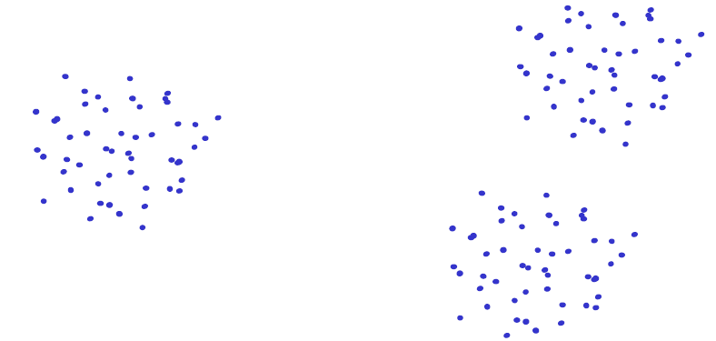
K-means
Disadvantages
Dependent on initialization

Slide 27
K-means
Disadvantages
Dependent on initialization

Slide 28
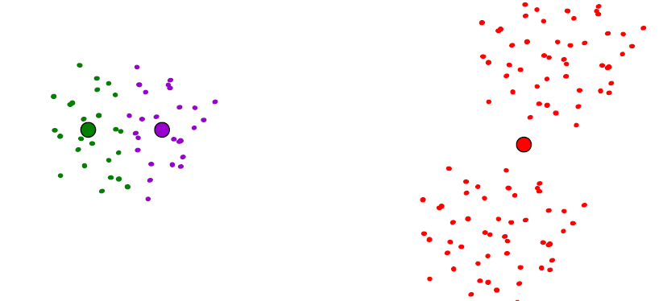
K-means
Disadvantages
Dependent on initialization

Slide 29
K-means
Disadvantages
Dependent on initialization
Select random seeds with at least D_{min}
Or, run the algorithm many times

Slide 30
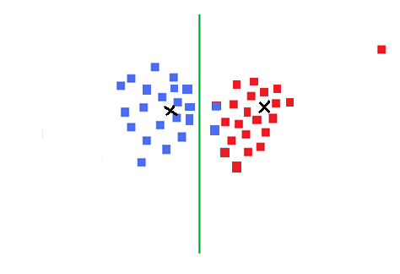
K-means
Disadvantages
Dependent on initialization
Sensitive to outliers

Slide 31
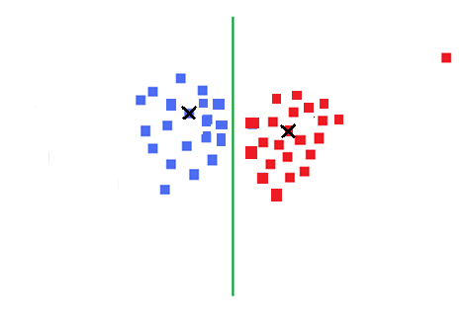
K-means
Disadvantages
Dependent on initialization
Sensitive to outliers
Use K-medoids
Notes:
Add definition of median

Slide 32
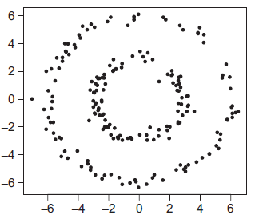
K-means
Disadvantages
Dependent on initialization
Sensitive to outliers (K-medoids)
Can deal only with clusters with spherical symmetrical point distribution
Kernel trick

Slide 33
K-means
Disadvantages
Dependent on initialization
Sensitive to outliers (K-medoids)
Can deal only with clusters with spherical symmetrical point distribution
Deciding K

Slide 34
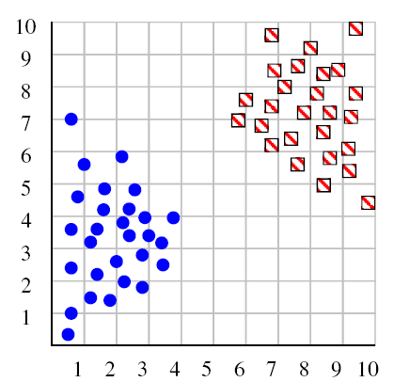
Deciding K
Try a couple of K

Slide 35
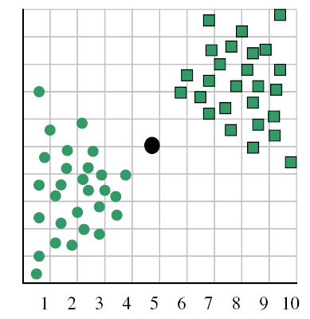
Deciding K
When k = 1, the objective function is 873.0

Slide 36
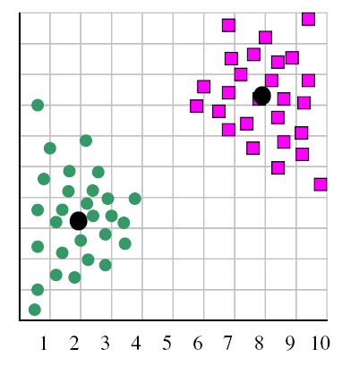
Deciding K
When k = 2, the objective function is 173.1

Slide 37
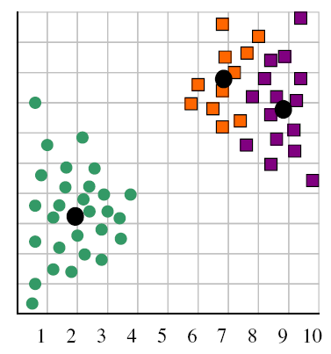
Deciding K
When k = 3, the objective function is 133.6

Slide 38
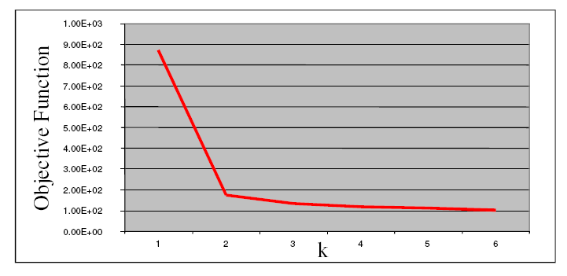
Deciding K
We can plot objective function values for k=1 to 6
The abrupt change at k=2 is highly suggestive of two clusters
“knee finding” or “elbow finding”
Note that the results are not always as clear cut as in this toy example

Slide 39
References
https://www.google.com/url?sa=t&rct=j&q=&esrc=s&source=web&cd=3&cad=rja&uact=8&ved=0ahUKEwjPh_62taDLAhUFuoMKHWi_BiIQFgglMAI&url=http%3A%2F%2Fwww.cs.unc.edu%2F~lazebnik%2Ffall09%2Fclustering_techniques_and_applications.pptx&usg=AFQjCNHUPHu4OlH4yY2ZRQeqfWxVv7eTvA&sig2=Bvi83S_TlUnXRkdi1IthvA&bvm=bv.115339255,d.amc

